Slide 1
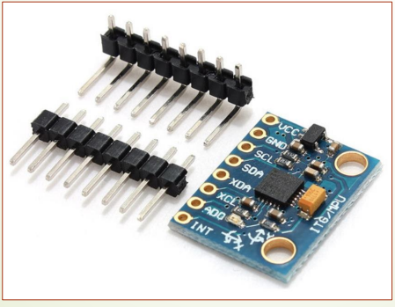
MPU-6050 Gyro Acc

Slide 2
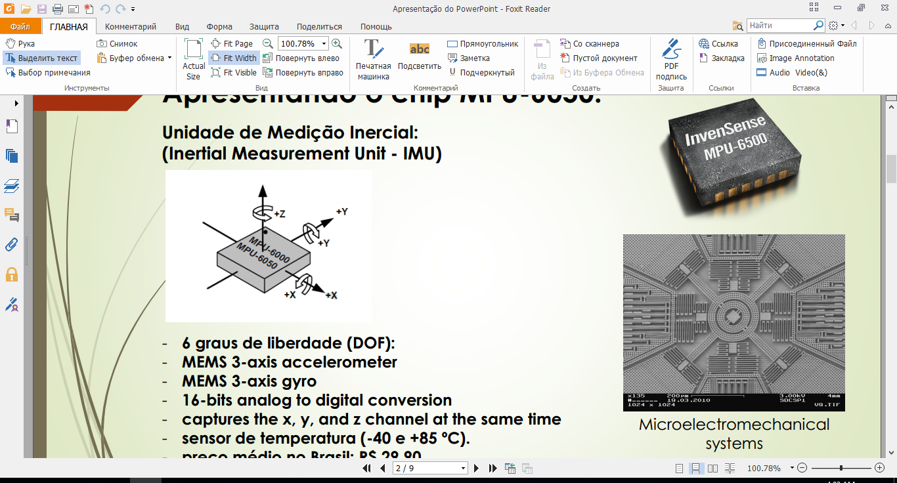
Inertsial Hisoblash Blogi (IMU – Inertial Measurement Unit)

Slide 3
- 6 graus of liberdade (DOF): - MEMS 3-axis accelerometer - MEMS 3-axis gyro - 16-bits analog to digital conversion - captures the x, y, and z channel at the same time - sensor of temperatura (-40 e +85 ºC).

Slide 4
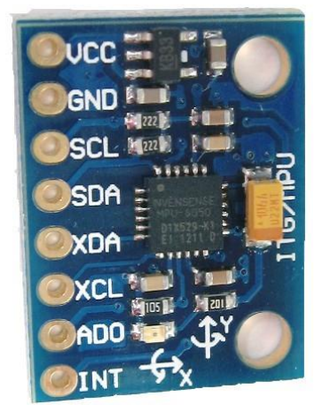
GY-521 da kiritish chiqarish.
GY-521 da ma’lumot almashish interfeysi I2C (I^2C) Inter Integrated Circuit orqali amalga oshiriladi.
(GY-521 pinlari)
- Vcc : Ta’minot (3,3V va 5V); - GND : 0V; - SCL : I2C Serial Clock (SCL); - SDA (Slave data): I2C Serial Data (SDA); - XDA : I2C Master Serial Data; - XCL : I2C Master Serial Clock; - AD0 : Define I2C; - INT : interrupt pin;

Slide 5
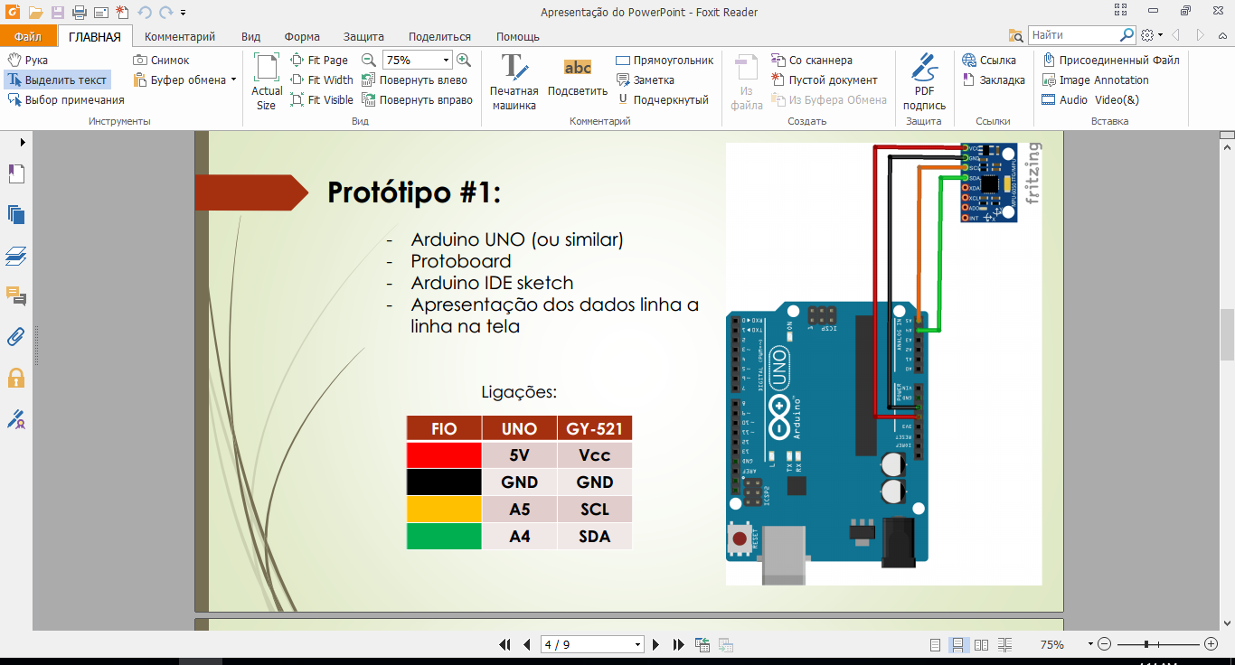
GY-521 va Arduino UNO (I2C communication)

Slide 6
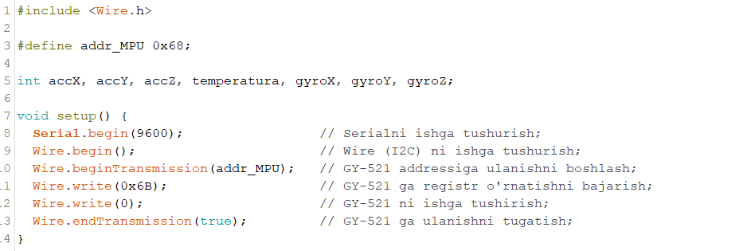
Arduinoda dastur kodi:

Slide 7
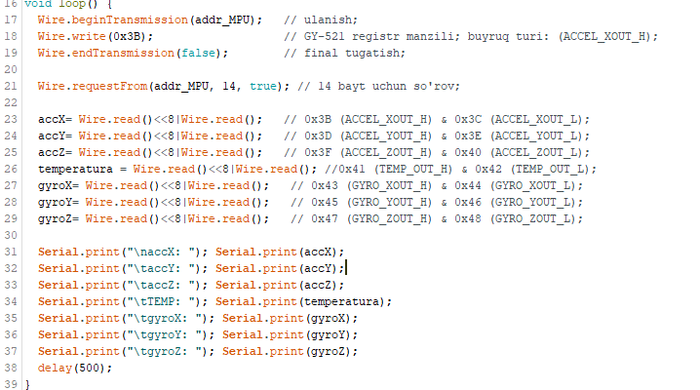

Slide 8
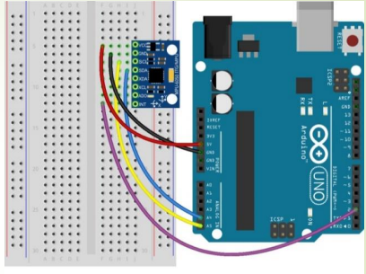
Arduino UNO va MPU-6050 (Interrupt)

